Slide 1
Quick Notes: Decimal->Binary->Decimal
N=15(8421)

Slide 2
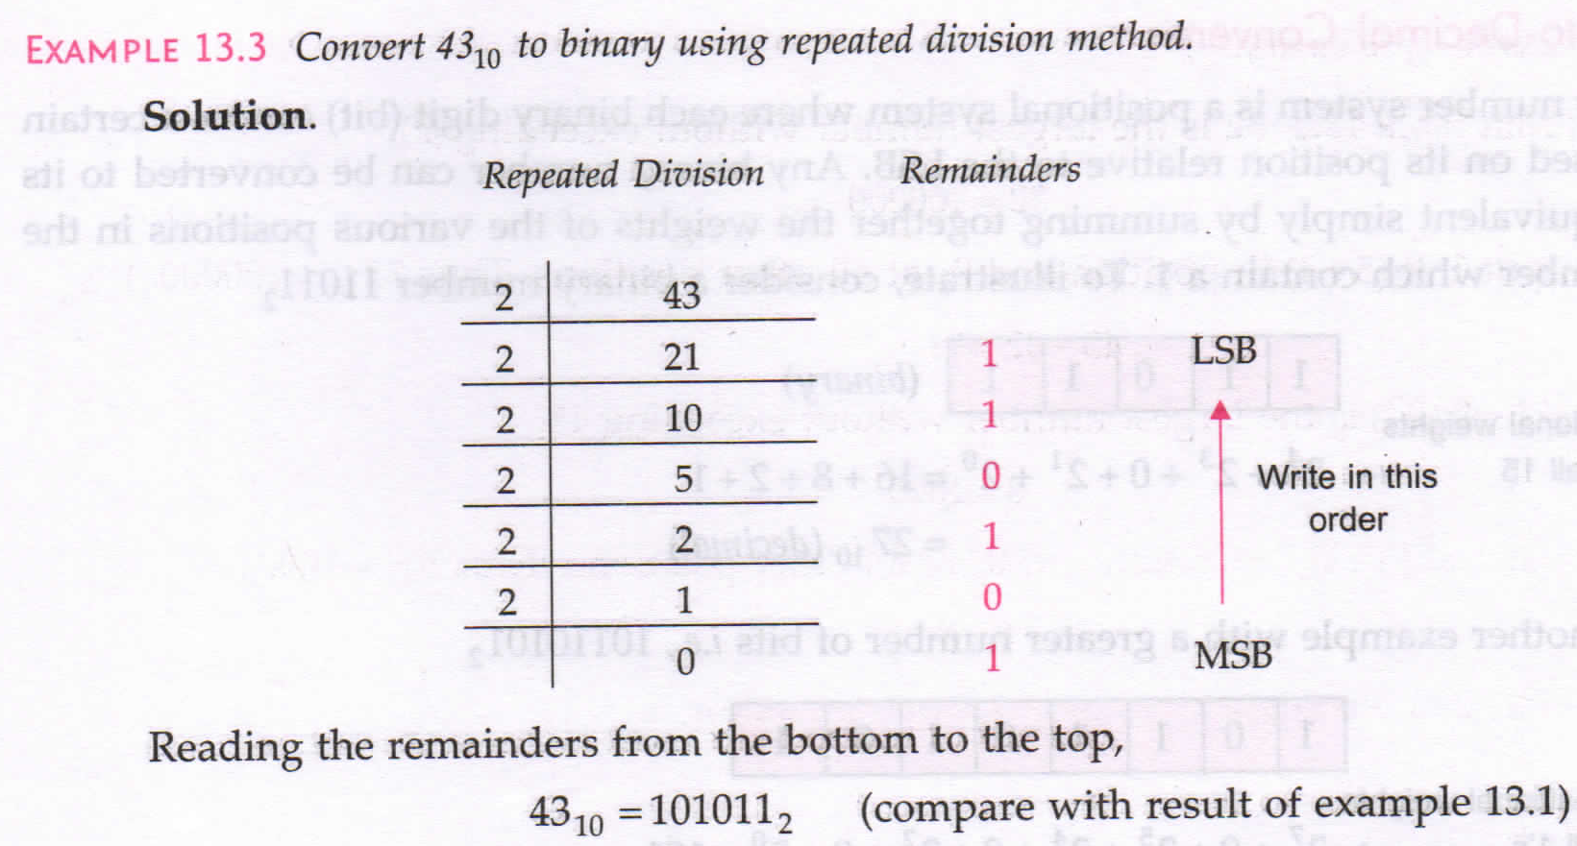
Decimal to Binary

Slide 3
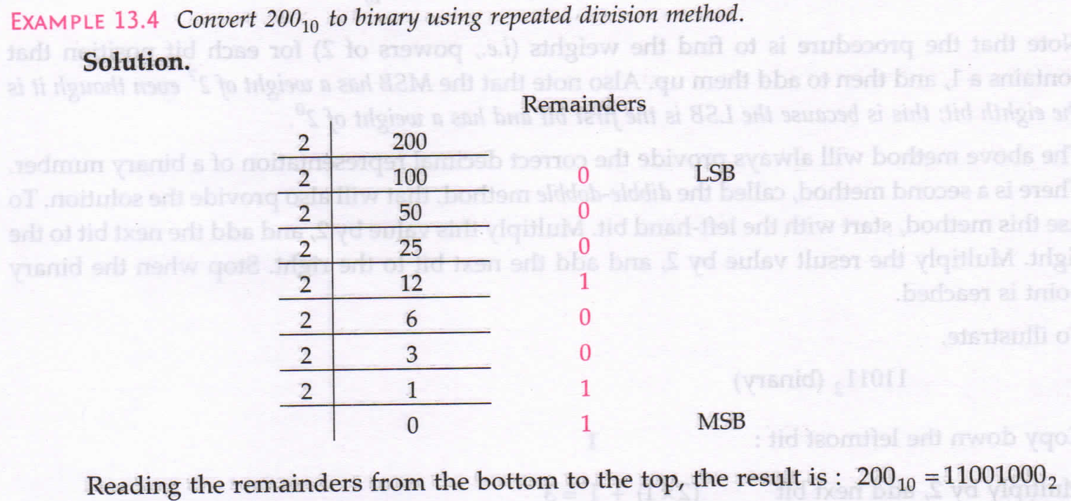

Slide 4
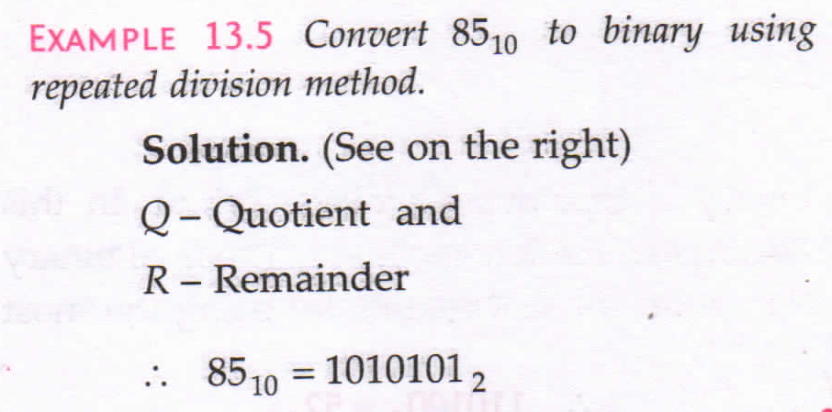
Method 03

Slide 5
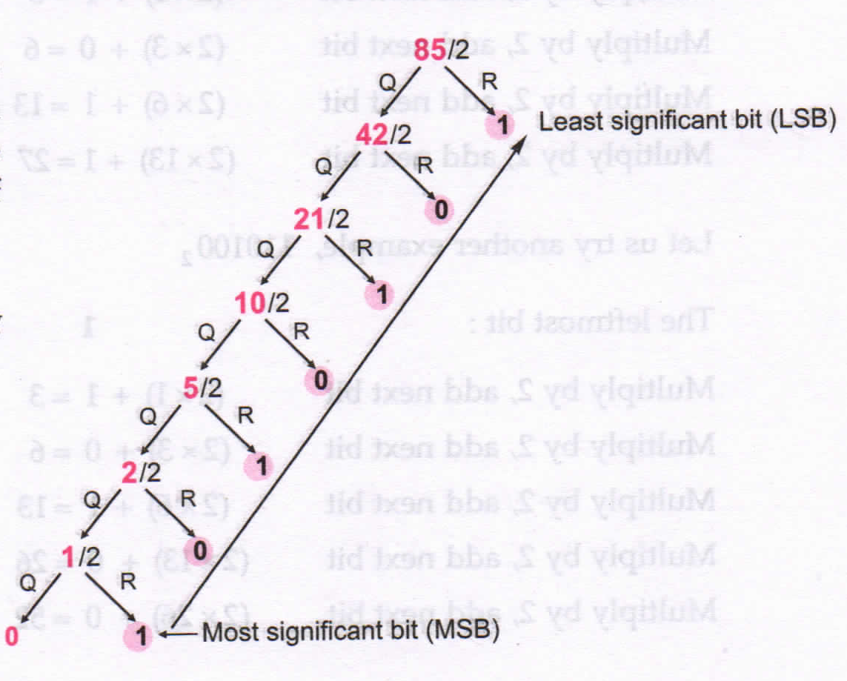

Slide 6
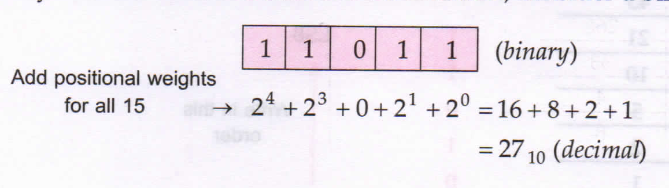
Binary to Decimal
11011
=>1x2^0 + 1x2^1 + 0x2^2 + 1x2^3 + 1x2^4
=>1 + 2 + 0 + 8 +16 = 27

Slide 7
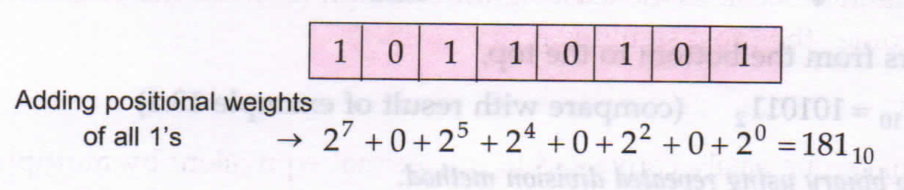
10110101
=>1x2^0 + 0x2^1 + 1x2^2 + 0x2^3 + 1x2^4+ 1x2^5 + 0x2^6 + 1x2^7
=>1 + 0 + 4 + 0 + 16 + 32 + 0 + 128 = 181

Slide 8
Solve it?
Example:-
Decimal to Binary Conversion
a) 25 = 01001(x) 11001(ans)
b) 36 (100100)
c) 100 ()
Binary to Decimal Conversion
a) 10001 (17)
b) 101010 (42)
c) 0001011 (11)

Slide 9
OR , AND , XOR
op = OR
0 op 0 = 0
0 op 1 = 1
1 op 0 = 1
1 op 1 = 1
101
110
----------
111(7)
op = AND
0 op 0 = 0
0 op 1 = 0
1 op 0 = 0
1 op 1 = 1
101(5)
110(6)
----------
100(4)
op = XOR
0 op 0 = 0
0 op 1 = 1
1 op 0 = 1
1 op 1 = 0
101
110
----------
011(3)

